Slide 1


SSM INSTITUTE OF ENGINEERING AND TECHNOLOGY DINDIGUL - 624 002
Department of Electronics and Communication Engineering
A Deep Learning Based Approach for Grading of Diabetic Retinopathy Using Large Fundus Image Dataset
Guided By,
Mr.Manikandan A ,AP/ECE
SSMIET.
Presented By,
Keerthana T (922119106039)
Madhumitha B (922119106051)
Mahalakshmi R M (922119106052)
Malini S (922119106053)

Slide 2
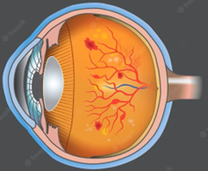
OBJECTIVE
To grade the severity of Diabetic Retinopathy (DR) which causes severe vision loss to diabetic patient. It is graded based on Deep Learning by using Large Fundus Image Dataset.

Slide 3
ABSTRACT
Diabetic Retinopathy affects one-third of all diabetic patients and may cause vision impairment.
It has four stages of progression, i.e., mild non-proliferative, moderate non-proliferative, severe non-proliferative and proliferative Diabetic Retinopathy.
The proposed research provides deep learning frameworks for autonomous detection of Diabetic Retinopathy at an early stage using fundus images.

Slide 4
We have used the Indian Diabetic Retinopathy Image Detect (IDRID) & Messidor Dataset to test the proposed frameworks.
Proposed framework were tested and compared on the large Fundus Image Dataset.
For classification purposes, random forest, k - nearest neighbors, and support vector machine are used as conventional algorithm.

Slide 5
INTRODUCTION
Diabetic Retinopathy (DR) is a chronic eye disease, commonly found in elderly people (age 50 or above), and can cause severe visual impairments or even blindness if not treated at an early stage [1].
DR is caused by the blood vessels rupturing due to high blood sugar levels.
DR is classified into two types, i.e., Proliferative and Non Proliferative Diabetic Retinopathy (NPDR).
PDR which results in complete blindness.
NPDR is graded into three stages ,
(i)Mild (ii)Moderate (iii)Severe NPDR
Severe NPDR is transmitted into PDR due to lack of proper and timely treatment.

Slide 6
LITERATURE SURVEY
TITLE | DESCRIPTION | PUBLICATION
Deep convolutional neural networks | Diabetic Retinopathy (DR) is a chronic eye disease, commonly found in elderly people (age 50 or above), and can cause severe visual impairments or even blindness if not treated at an early stage | Gonzalez, R.C on 2018 (IEEE Signal Process)
Diabetic Retinopathy | Among these 387 million people, 93 million people are with positive DR. | Shukla, U.V.; Tripathy, K on 2022(https://www.ncbi.nlm.nih.gov)
A Deep Learning Based Pipeline for Image Grading of Diabetic Retinopathy. | The developed techniques covered conventional image processing machine learning, optimization, deep learning, and now explainable models. Wang Yu, proposed a research [6] framework | Wang, Y.; Wang, G.A.; Fan, W.; Li, J on 2018(International Conference, ICSH, Shenzhen, China)

Slide 7
TITLE | DESCRIPTION | PUBLICATION
Diabetic Retinopathy Image Classification Using Support Vector Machine. | Used a different approach that focused only on important features and exudates on retina to predict the condition of the disease, since they play a significant role in detecting the severity of disease. | Behera, M.K.; Chakravarty, S on 2020 (https://ieeexplore.ieee.org)
Diabetic Retinopathy Stages Classification using Improved Deep Learning. | Worked on basic CNN architecture of VGG and achieved an accuracy of 99.9% using the Messidor dataset and 98% accuracy using the Kaggle dataset. | Sudarmadji, P.W.; Pakan, P.D.; Dillak, R.Y. on 2020 (https://dx.doi.org)
Automated Diabetic Retinopathy Grading using Resnet. | Pre-processed the images using normalization and augmentation, followed by feature extraction. | Elswah, D.K.; Elnakib, A.A.; Moustafa, H.E. on 2020 (https://ieeexplore.ieee.org)

Slide 8
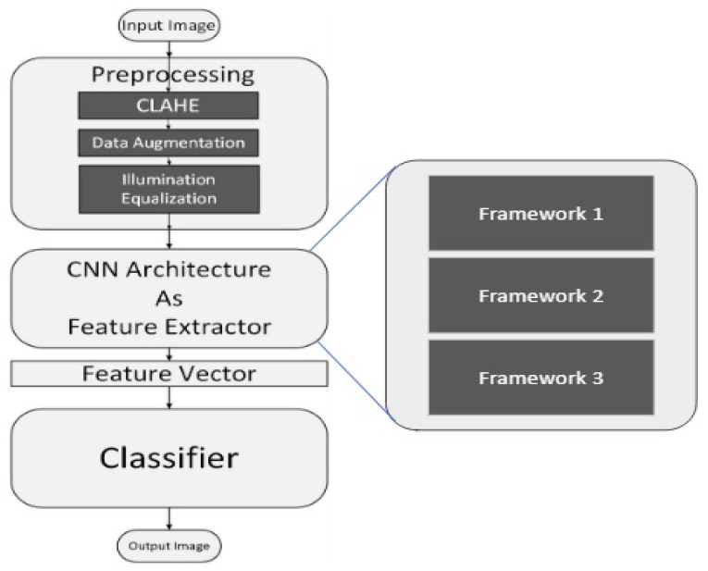
Block diagram of the proposed algorithm

Slide 9
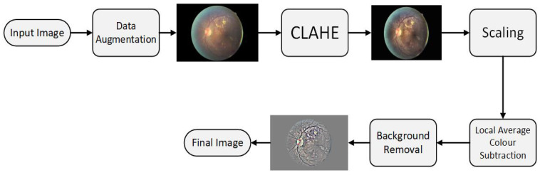
Pre-processing phase
DATA AUGMENTATION – Flipping to 90 degree, rotating image by (0,180) degree.
CLAHE – Algorithm used Contrast Limited Adaptive Histogram Equalization.
SCALING – Pixel Size [300 PIXELS OR 500PIXELS].
COLOUR NORMALIZATION AND BACKGROUND REMOVAL – Removed Background and Unwanted Details.
Gray Scale Mapping – Local Average to 50% Gray Scale image.
Resizing – Finally we Resized to 256 x 256.

Slide 10
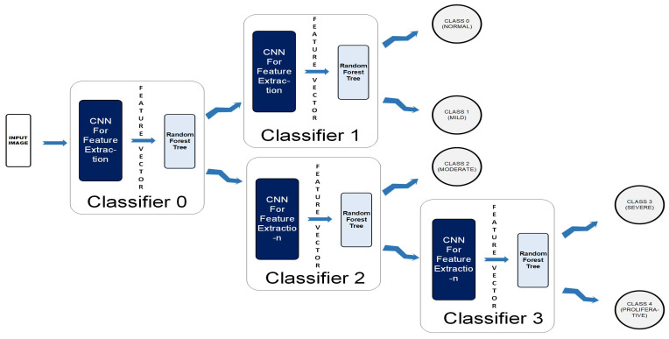
CNN ARCHITECTURE FOR DEEP FEATURE EXTRACTION
FRAMEWORK 1 – CASCADED CLASSIFIER
A Colored Fundus image(256 x 256 x3) is fed to the CCN as input.
The output map is sequentially forwarded from the previous one to the next four classifiers within the CCN.
The new test color fundus image moves node-wise and ultimately reaches one of the five leaf nodes (terminal nodes) for final decision-making.
Finally, it can be classified among one the five classes: Normal, Mild, Moderate, Severe, and Proliferative.

Slide 11
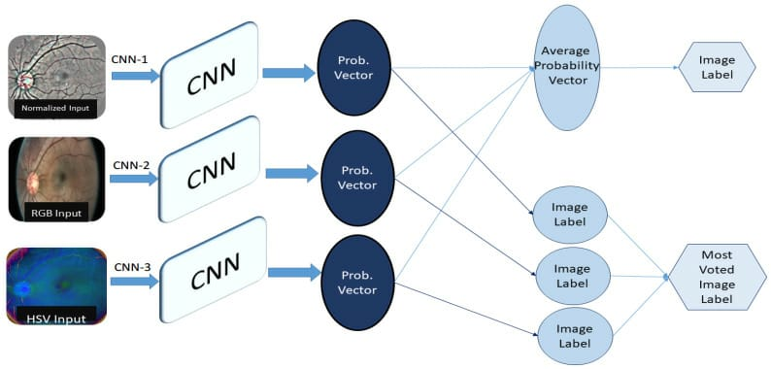
FRAMEWORK 2
In framework 2 , there are 3 different types of pre processed datasets.
1. Normalized (CNN-1)
To remove unwanted information.
2. RGB (CNN-2)
Intensity value of three primary colors red,green and blue combined shows 1 colours.
3. HSVC (CNN-3)
Hue – Angle on colored spherical surface.
Saturation – Light or dark.
Value – Measure of brightness.

Slide 13
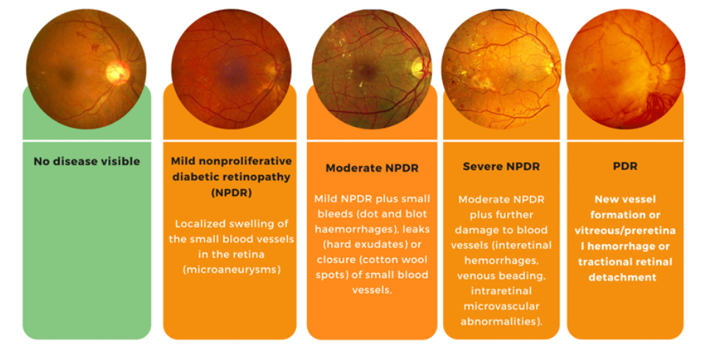
CLASSIFIER

Slide 14
REFERENCES:
1. Taylor, R. & Batey, D. Handbook of Retinal Screening in Diabetes: Diagnosis and Management. Wiley (2012).
2. Wang, F., Casalino, L. P. & Khullar, D. Deep Learning in Medicine-Promise, Progress, and Challenges. JAMA Intern Med. (2018).
3. Guan, M. Y., Gulshan, V., Dai, A. M. & Hinton, G. E. Who Said What: Modeling Individual Labelers Improves Classification. arXiv e-prints., https://ui.adsabs.harvard.edu/\#abs/2017arXiv170308774G. (Accessed March 01, 2017).

